Slide 1
PHP and HTML
Arafat Hassan

Slide 2
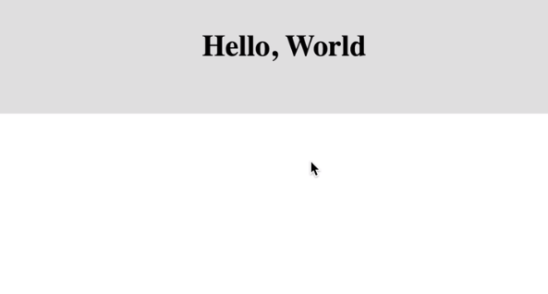
PHP and HTML
Recall that HTML code can be written in .php files.
Create an html page that looks like this -

Slide 3
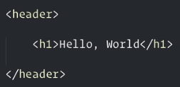
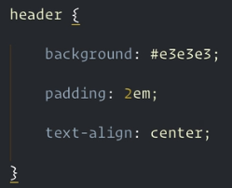
PHP and HTML
The HTML - The CSS -

Slide 4
PHP and HTML
Instead of keeping the h1 tag static, we can make it dynamic and link php to it.
Or you can use the shortcut -
Here <?= ?> stands for <?php echo ; ?>

Slide 5
PHP and HTML
Now we want to pass data to the page through the url.
We can do that by making a get request.
A “get request” is a way of sending data to the server. We can make a get request like this -
url?var1=value1&var2=value2&var3=value3
The start of variable-value pairs should be marked with a ‘?’
You can write as many variable-value pairs as you want. Just join them with an ‘&’

Slide 6
PHP and HTML
So instead of our page always saying hello to the world, we can have it greet anyone else.
So, the new request becomes url?name=jeff
In order to access this variable and data inside your php code, we use the $_GET superglobal.
Superglobals are variables that you can access absolutely anywhere in your php code because they have already been initialized by someone else.
$_GET[‘name’] gives you ‘jeff’. You can treat $_GET as an associative array

Slide 7
PHP and HTML
So now the code becomes -
The request -
The output - “Hello Jeff”
Play with this on your own. Try to do interesting stuff with get requests.

Slide 8
Sanitizing the input

Slide 9
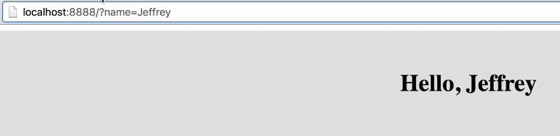
Sanitizing the input
Let’s say we have this setup -

Slide 10
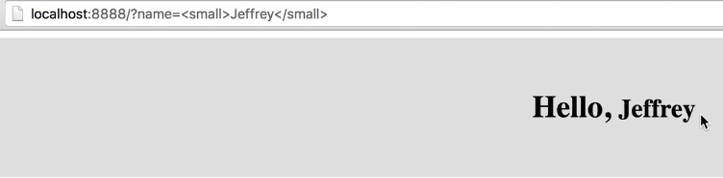
Sanitizing the input
But what if the user, instead of inputting name=Jeffery, inputs something weird?
Notice how inserting HTML code in the get request effects the page!

Slide 11
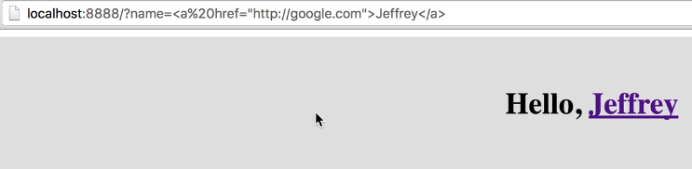
Sanitizing the input
Or this?

Slide 12
Sanitizing the input
Now you might wonder if any user in his right mind would ever do that. And the answer is, they WILL.
One established idea in engineering is that your users are guilty until proven otherwise. So you should NEVER trust your users to do things the right way.
Such weaknesses can allow users to inject malicious code into your website. So we need to sanitize their input to ensure nothing like that happens.
For that, we use htmlspecialchars() function. This function tells the browser that there are no special characters here, and that the string should be treated as a normal text.

Slide 13
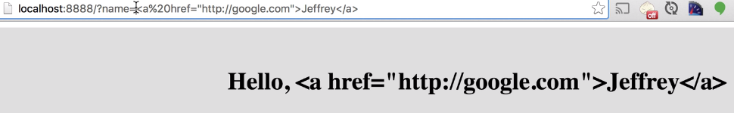
Sanitizing the input
So this is what you should do now -
The result -
Exactly what should happen!

Slide 14
Separating PHP logic from presentation

Slide 15
Separating PHP logic from presentation
Our code is simple now, and all we are doing is getting a value from the url and displaying it.
But you may have to other more complex processing on the data. Maybe you would want to insert the data in a database. Maybe you want to check if it exists in the database before you insert it. And so on.
In that case, you have two different concerns in one file - Processing the data and displaying the data.

Slide 16

Separating PHP logic from presentation
Separation of concerns is a very important principle in programming.
We do that by creating another file index.vie.php in the same directory
Copy paste all the code to index.view.php and make this change -

Slide 17
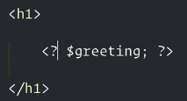
Separating PHP logic from presentation
Use any normal variable here -

Slide 18
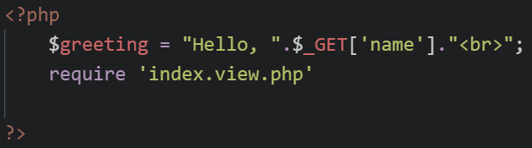
Separating PHP logic from presentation
And in index.php -
Require tells the computer to import everything from index.view.php. So it is as if all the contents of index.view.php is pasted in index.php
Ultimately, this gives the same effect, but with the advantage that logic and presentation has been separated.

Slide 19
PHP Form Handling

Slide 20
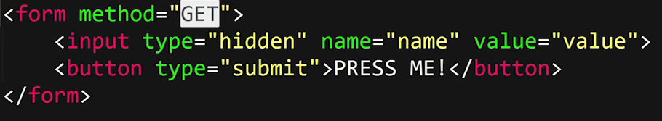
Form Handling
Consider this HTML form. The expression method=”GET” tells the program to send the values using a get request when submit is clicked.
We have already seen how data is sent through get requests. The important thing to note is that the data can be seen in the URL.

Slide 21
Form Handling
This is unlike the POST method where the data can not be seen in the URL.
$_POST is another superglobal. The data sent through POST method can be accessed using this superglobal just like we have seen with get.
Let’s take a look at some examples.

Slide 22
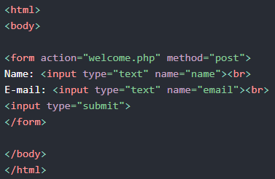
Form Handling
Consider this form -

Slide 23
Form Handling
When the user fills out the form above and clicks the submit button, the form data is sent for processing to a PHP file named "welcome.php". The form data is sent with the HTTP POST method.
To display the submitted data you could simply echo all the variables. The "welcome.php" looks like this:

Slide 24
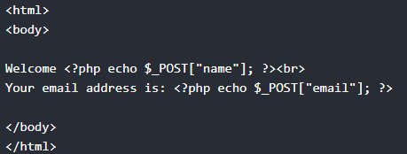

Form Handling
Output -

Slide 25
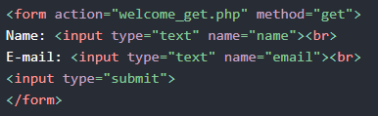
Form Handling
The same result could also be achieved using the HTTP GET method:

Slide 26

Form Handling
Welcome.php -
This code is very simple, written for an example. Can you guess what’s wrong with this code?
If you are thinking about sanitizing your inputs, then you are right!
When coding for yourself, don’t forget to sanitize your input as shown earlier.

Slide 27
Form Handling
Apart from sanitizing the input, there is another problem. A user may types in url/welcome.php to access that file directly.
Since no get or post data is being sent this way, this will certainly give an error.
To prevent the user from accessing welcome.php except through submitting the form, there is a nice trick.

Slide 28
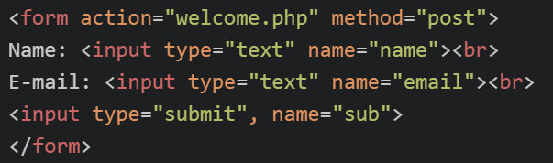
Form Handling
We assign a name to the submit button like this (in index.php) -
When submit button is pressed, the post request will have another value-key pair: name=>type. In this case, it is sub => submit

Slide 29
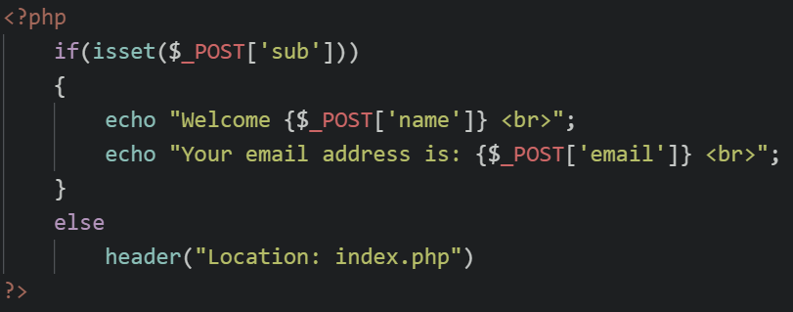
Form Handling
In welcome.php, we check if the user has come to this page by clicking the submit button in index.php. In that case, the value of $_POST[‘sub’] will be set to ‘submit’. (note that curly brackets are mandatory to access arrays inside double quotations)

Slide 30

Form Handling
If not, then we redirect him back to index.php using the header function.
If you wanna display an error message after redirecting, you can use the get request.
Simply change the redirect url as such -
And handle it in index.php

Slide 31
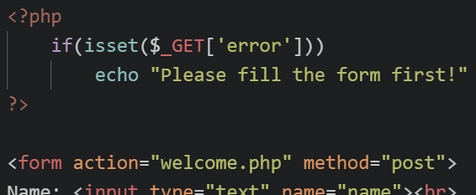
Form Handling
Add this on top of index.php

Slide 32
Other superglobals in PHP

Slide 33
Superglobals
Some important superglobals in PHP -
$GLOBALS
$_POST
$_GET
$_COOKIE
$_SESSION
We have already seen the use of get and post. Let’s see the others.

Slide 34
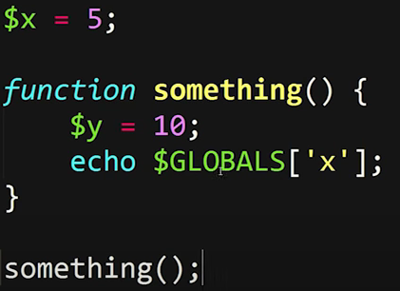
Superglobals
$GLOBALS can be used like an associative array to access any global variable -
This snippet echos 5.

Slide 35
Superglobals
A cookie is often used to identify a user. A cookie is a small file that the server embeds on the user's computer. Each time the same computer requests a page with a browser, it will send the cookie too. With PHP, you can both create and retrieve cookie values.
The following example creates a cookie named "user" with the value "John Doe". The cookie will expire after 30 days (86400 * 30). The "/" means that the cookie is available in entire website (otherwise, select the directory you prefer).

Slide 36
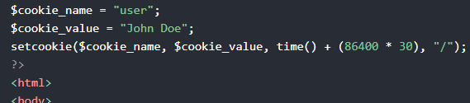
Superglobals
We then retrieve the value of the cookie "user" (using the global variable $_COOKIE). We also use the isset() function to find out if the cookie is set:
Note that setcookie() must appear before the <html> tag

Slide 37
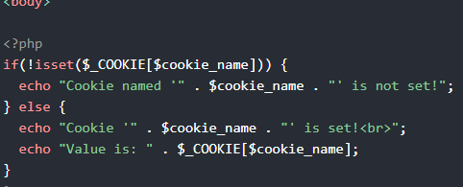
Superglobals

Slide 38
Superglobals
To modify a cookie, just set (again) the cookie using the setcookie() function.
To delete a cookie, use the setcookie() function with an expiration date in the past.

Slide 39
PHP Session
When you work with an application, you open it, do some changes, and then you close it. The problem is that the web server does not know who you are or what you do, because the HTTP address doesn't maintain state.
Session variables solve this problem by storing user information to be used across multiple pages (e.g. username, favorite color, etc). By default, session variables last until the user closes the browser.
So, Session variables hold information about one single user, and are available to all pages in one application.

Slide 40
PHP Session
This is particularly useful when the user has logged in, and you don’t want him to login again, every single time he visits a new page.
A session is started with the session_start() function.
Session variables are set with the PHP global variable: $_SESSION.
Now, let's create a new page called "demo_session1.php". In this page, we start a new PHP session and set some session variables:

Slide 41
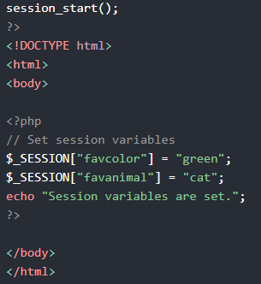
PHP Session
Session_start() should be at the very beginning of the file.
This function checks if a session is active. If there is, the it access that session. If not, a new session is started.

Slide 42
PHP Session
Next, we create another page called "demo_session2.php". From this page, we will access the session information we set on the first page ("demo_session1.php").
Notice that session variables are not passed individually to each new page, instead they are retrieved from the session we open at the beginning of each page (session_start()).
Also notice that all session variable values are stored in the global $_SESSION variable:

Slide 43
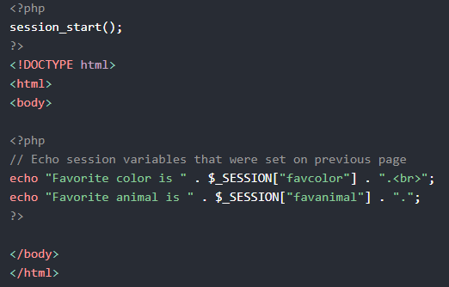
PHP Session

Slide 44
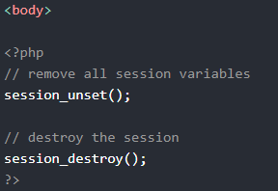
PHP Session
To end the session, for example when the user logs out, you can use session_unset() and session_destroy(). They remove all global session variables and destroy the session.

Slide 45
Challenges

Slide 46
A word of warning...
For each of the projects, you MUST separate the logic from presentation.
So generally it is expected that each page will have two php files. One for the presentation, and one for the logic.
The number of files do not matter. You can have your own way to separate the concerns.
Separating the concerns is absolutely mandatory for the following projects.

Slide 47
Fake Signup system

Slide 48
Fake Signup System
We will design a fake signup system. The system is fake in that there is no persistent database involved. Only php session. So when the session expires, the system will forget the data.
Also when the user manually logs out, the system will forget his data and he will be able to register again with the same data.
So there is no support for logging in now. Only signing up.
But that’s fine for now. We will later see how to create a full fledged login system later on.

Slide 49
Fake Signup System
Design a signup page that requires a name, email address, password, confirm password.
Design a simple homepage.
There should also be a logout button on the homepage.
A user can not visit the homepage unless he sign up. Even if the url for the homepage is types, he will be redirected to the sign up page WITH an error message.

Slide 50
Fake Signup System
After successful sign up, the user is taken to the homepage where he can see -
A “Thank you for signing up” message that can be seen once only, after signing in.
A “Welcome (name)! Your email address is (email).” message
A logout button
Once signed up, the user can visit the homepage everytime by typing the URL.

Slide 51
Fake Signup System
Once signed in, the signup page will redirect users to the homepage WITHOUT error message.
Logout button closes the session and logs user out.
In order to sign up, the password and confirm password fields must match. Otherwise an error message will be displayed and the user will be prompted to enter the credentials again. But in this process, the name and email field will not be emptied if the user had typed anything into them previously.
The sign up will also fail if any of the fields are empty.

Slide 52
Online Calculator

Slide 53
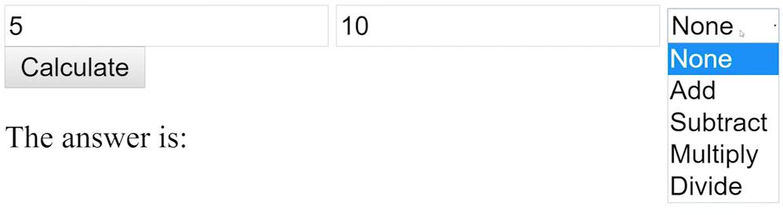
Online Calculator
Design a calculator like this -

Slide 54
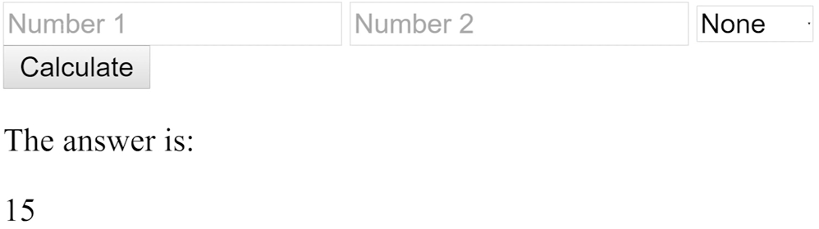
Online Calculator
Design a calculator like this -

Slide 55
Merging the two

Slide 56
Merge
Try to merge the two. Can you place your calculator in the home screen of your “fake sign up system”?
That way no one should be able to use the calculator without signing up

Slide 57
Matrix calculator

Slide 58
Matrix calculator
Can you make a calculator for a 2x2 OR 3x3 matrix?
The calculator will have options to only calculate 2x2 matrix with another 2x2 matrix, or a 3x3 with another 3x3 and nothing else.
It will give you options to do matrix addition, subtraction, matrix multiplication, scalar multiplication, determinant, and inverse.
There are no design requirements - just the bare minimum to make the system useable.

Slide 59
Boss level Challenge

Slide 60
Boss Level Challenge
Can you merge all the three projects together?
So now the homepage has multiple links / buttons. One to access the basic number calculator, one for 2x2 matrix calculator, and one for a 3x3 calculator. Each one will take the users to the corresponding page.
Every page in this project will have the same header. The header can simply consist of a welcome message displaying the username and his email address.
But none of those pages should be accessible without signing up.

Slide 61
Boss Level Challenge
At this point, you might find yourself having to duplicate the code for the header in the php code for every single page. This is not good.
You should separate the code for the header in one file and include or “require” the file in every page. This way there will be no code duplication.
But none of those pages should be accessible without signing up.

